Slide 1


The Open INcentive Kit (OINK): Standardizing the Generation, Comparison, and Deployment of Incentive Systems
Noah Klugman†, Santiago Correa*, Pat Pannuto†, Matthew Podolsky†, Jay Taneja*, and Prabal Dutta†
ACM ICTDX, Jan 7st, 2019
Ahmedabad, India
†
*

Slide 2
Application: Sensing AC grid reliability in Ghana
Achimota, Accra, Ghana
https://www.youtube.com/watch?v=NzBGBXrwVYc
Notes:
I thought I would introduce our system, the Open Incentive Kit, or OINK, by telling it’s origin story. This starts when I was approached by a group of researchers who were interested in exploring the reliability of the low voltage AC power grid in Accra, which is the capital city of Ghana and the recently announced location of COMPASS 2019. Our group had been developing sensors that measure energy reliability and we were pretty excited to try deploying them at some scale in the field.

Slide 3
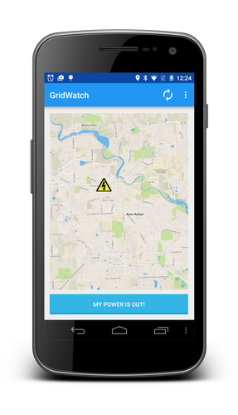
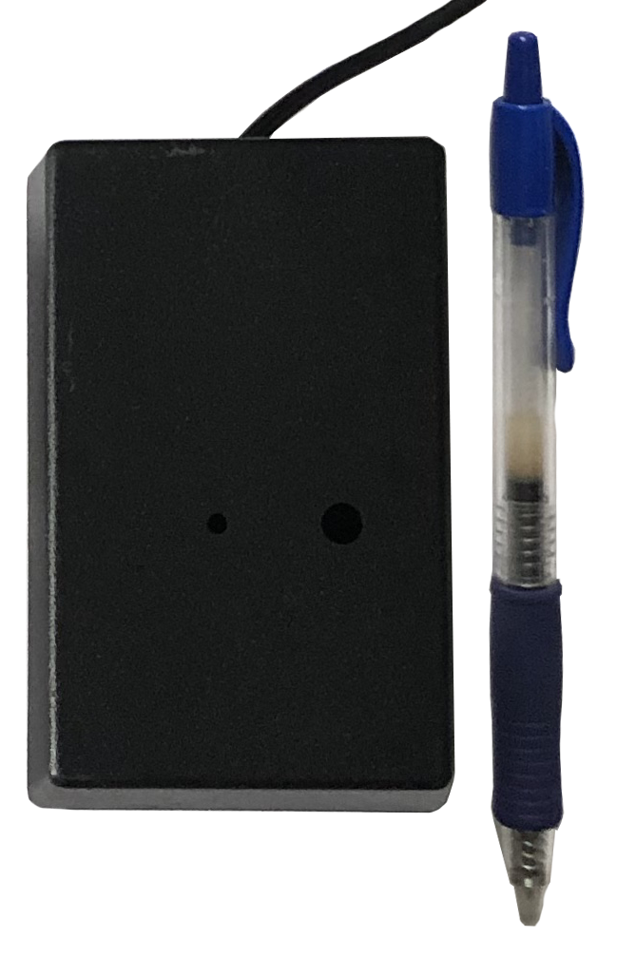
Let’s start putting together a deployment…
?
GridWatch^{[2]}
PowerWatch^{[3]}
[2] Klugman, N., et al. “Grid watch: Mapping blackouts with smart phones” Hotmobile 2014
[3] Klugman, N., et al. ”Demo: Android Resists Liberation from Its Primary Use Case." MobiCom 2018
Notes:
So agreed to do a pilot deployment of two technologies we were developing, GridWatch and PowerWatch, both of which measure energy reliability. [*] GridWatch is an app that detects power outages using sensors built into smartphones and [*] PowerWatch is a sensor that plugs into the wall and detects power outages as well as voltage quality. For our experiment, GridWatch would be installed on participants smartphones and PowerWatch would be installed at outlets in both households and firms. Because both of our technologies cause participants to incur small costs, it made sense to incentivize people for participation. After talking with our Ghanian project manager about what local participants might respond well to, we decided that the best form on incentive would be airtime credit, which a participant could use to make phone calls or use the internet.

Slide 4
Challenge: Incentivize people for many things
Personal Interaction
GridWatch
PowerWatch
Consent/Baseline
Install
Install
Endline
Monthly
Monthly
In-app Invite
Post-experiment
collection
Accountability?
Audits?
Complicated execution?
Notes:
The thing is… by the time our entire experiment was planned, our incentive scheme had become complex. [*] Participants were incentivized for a baseline survey [*] as well as an endline survey [*]. Participants using GridWatch [*] received a single incentive for installing the app [*], monthly incentives for keeping the app installed [*], and up to 5 incentives for each time they invited other people [*] to install the app. Participants using PowerWatch [*] received an single incentive for installing the sensor in their house [*], monthly incentives for keeping it plugged in [*], and an incentive for making themselves available at the end of the study to pick up the sensor [*]. Further, we were aiming for over two thousand participants in our study. With such a complicated incentive system and at our desired scale, we quickly became worried about accountability [*] and auditability[*]… how do we make sure all incentives were transferred on time, to the right people, and for the right amount… how can we prove to others that our incentives were transferred correctly. We also worried about complexity of executing [*] our incentive scheme… how do we let field officers know when it was time to transfer airtime for the less traditional incentive triggers such as keeping an app installed monthly, how do we coordinate with all of our participants for the actual incentive exchange?, how do we transfer thousands or tens of thousands of incentives accurately?

Slide 5
Solution: Scripting?
IT seems critical
Lots of pieces are done for us…
Incentives transfer is already digital
Some behavior monitoring tools exist
Databases support logging of transactions
Our incentive systems have common patterns
Something happens that someone gets an incentive for
Notes:
Ok. Well… IT can provide an avenue for implementing complex incentive schemes. [*] Without IT, training field officers to do this work would have been really hard and expensive [*] Also, IT lets us take advantage of some previously existing infrastructure. For example, [*] we were able to automate the use of online banking software to transfer airtime to participants without having to visit them, which was critical for running our deployment at scale. And we could use Google tools [*] to track complicated things like whether an app is still installed. Similarly [*], we could track all incentives transferred during our deployment in a database and recall these logs to manage and audit incentive schemes in our experiment. Additionally, as we started planning the software to run our incentive scheme, [*] we noticed that for each of the things we were incentivizing people for… installing a sensor, keeping a app installed for a month, doing a survey, etc, each one of these things shared some basic pattern. [*] Something happened and then we sent an incentive in response. The presence of this base pattern allowed us to imagine a system that would let us reuse some code across incentive types and ultimately simplify software development.

Slide 6
What do other researchers do?
Incentive systems influence participation and population
175 papers and abstracts from ACM DEV, CHI, and ICTD
215 papers from medical education journals ^{[1]}
Sorted into:
No human subject
No mention
Some mention
Discussed
No Mention
Some Mention
Discussed
55%
31%
14%
[1] Stovel, R. G., et al. "Incentives for recruiting trainee participants in medical education research." Medical teacher
No Mention
Some Mention
Discussed
No Mention
Some Mention
Discussed
No Mention
Some Mention
Discussed
No Mention
Some Mention
Discussed
No Mention
Some Mention
Discussed
No Mention
Some Mention
Discussed
55%
31%
14%
55%
31%
14%
55%
31%
14%
55%
31%
14%
55%
31%
14%
55%
31%
14%
[1] Stovel, R. G., et al. "Incentives for recruiting trainee participants in medical education research." Medical teacher
[1] Stovel, R. G., et al. "Incentives for recruiting trainee participants in medical education research." Medical teacher
Notes:
Still, before writing a new incentive management system from scratch, we decided to pause and look into how other people design and implement incentive systems. We did this by performing a literature review. And… well… honestly we didn’t find much at first. This was really surprising to us [*] as it is widely understood that incentive systems design can have huge impact on the results of a human subjects study. So… we decided to go a bit deeper than we first expected to dig... We ended up looking at [*] 175 papers and abstracts, primarily taken from ACM DEV but also taken from CHI and ICTD. [*] We also replicated parts of a similar related work search in the medical education community that looked incentive systems described in 215 papers from their relevant journals. [*] For each paper we first determined if the experiment being described in that paper [*] had human subjects. If it did, we would then classify the paper as having [*] either no mention of the incentive system used, [*] some mention, or having [*] discussed the incentive system in specific detail. Now, these labels are a bit subjective, but generally, a paper was classified as some mention when it simply touched on participants being incentivized, and was classified as discussed when it talked about details like how the incentive was transferred, the type of incentive, and or the amount of incentive. The overall numbers that we found sort of shocked us [*]. 55% [*] of papers reporting on a human subject experiment did not mention their incentive systems at all, which feels really high. 31% [*] had some mention, and only 14% discussed the incentive system in detail. And, going back to the reason we started this related work search in the first place, we found no papers that described tools we could use to bootstrap the implementation of the incentive scheme for our deployment.

Slide 7
Incentive schemes need to be modernized
Observations:
Incentive schemes are critically important and under reported
Incentive schemes are implemented ad-hoc
Incentive schemes share patterns
We depend on IT to implement complicated incentive systems
What if this wasn’t the case?
Could we lower the barrier for running experiments with incentives?
Could this enable better reporting in the literature?
Notes:
So. Not great. Lets recap… at this point in our story, [*] we have four main observations. [*] Incentive schemes are both important and under reported in the literature. [*] No tools are described in the literature that provide guidance about how to implement complex incentive schemes. Rather, it seems that an experimenter is expected to figure this out for themselves for each new experiment. [*] All the incentive schemes we came up for our experiment share some common patterns. [*] We could not have fully implemented our experiment without the support of IT. [*] All together, this caused to step back and ask, what if there was a technology that helped people implement incentive schemes? [*] Can something generate incentive schemes without requiring the help of an software engineer? Would such a system allow for better accountability and auditability than would easily exist without IT? [*] And could such a system standardize how incentive systems are described, perhaps making it easier to report on and compare incentive systems used across different studies?

Slide 8
The Open INcentive Kit (OINK)
We introduce the Open INcentive Kit, or (OINK), which we hypothesize could support and automate the design, deployment, and management of a broad range of incentive systems, both to facilitate the description and comparison of incentive systems in the literature, and to reduce their overhead while increasing their quality
Notes:
With this all in mind, we introduce the Open INcentive Kit, or (OINK), which we hypothesize could support and automate the design, deployment, and management of a broad range of incentive systems, both to facilitate the description and comparison of incentive systems in the literature, and to reduce their overhead while increasing their quality.

Slide 9
Vocabulary to describe incentive systems
Stimulus
Experiment
Fraud
Identity
Incentive System
Payment
Stimulus
Incentive System
Alarm
Fraud
Payment
Alarm
Notes:
Great. So let’s jump into some details of OINK. We aim for OINK to be able to support wide ranges of incentive schemes. To achieve this, we went back through the papers that described their incentive scheme in detail, collected these details, and extracted all common patterns between incentive scheme. We then used these patterns to derive a vocabulary, which is able to describe all incentive schemes we found descriptions of. The first word in this vocabulary is [*] experiment, which we define as a collection of one or more incentive systems that share common participants. The second word is identity [*] which we define as information about a participant or field officer saved in the experiment that is accessible to all incentive systems within the experiment. The third word, I guess it’s a phrase, is Incentive System [*] which we define as a system that keeps track of when a given amount of incentive should be sent, what incentive should be sent, to whom an incentive should be sent, and whether an incentive was transferred. The final words are those that allow us to implement an incentive system [*] and include stimulus [*], which we define as the trigger event for the transfer of an incentive, fraud detection [*], which we define as the set of verification rules that can stop undesired incentive transfer, payment [*], which we define as the logic to transfer an incentive, and alarm [*] which we define as a method of notifying the experiment staff. One experiment can have multiple incentive systems [*], and then each incentive system has its own stimulus, fraud, payment, and alarm logic.

Slide 10

Software Structure
Alarm
Fraud
Detection
Core
Stimuli
Stimuli
Core
Payment
Notes:
We implement OINK using a structure that is based on the words of our incentive system vocabulary just introduced. Let’s walk through how this works at a high level. We start with a participant [*]. This participant does something we wish to incentive them for. This could be a survey being uploaded, an app being installed, an app staying installed, or many other things. It doesn’t really matter as long as there is a method so that when the action being incentivized occurs, OINK is triggered. We call this trigger a stimuli. [*] Along with the stimuli, OINK needs to know how much to incentive, and to who. OINK then calls a fraud detection [*] function which contains rules that can prevent the system from triggering an unattended incentive transfer. For example, a fraud detection function can ensure that a participant receives no more than a maximum amount of incentive. The next function called is the core function [*], which provides logging and data cleaning. After this, [*] a payment function provides logic to transfer an incentive to a user. For example, a payment function could send some mobile money to a participant. The payment result is collected by the [*] core function, logged, and then passed to a [*] stimulus function which writes the result into a database. OINK then does stimuli specific response for example, sending a conformation of payment SMS.[*] Finally, [*] alarms monitor the whole system [*] and can generate email or sms’s at any point if anything goes wrong.

Slide 11
App Invite
Fraud
Detection
(max invites)
Stimuli
(app invite)
Core
Stimuli
(app invite)
Core
Payment
(Korba)
Notes:
OK. Let’s try to make this a bit more real with a specific example how we used OINK to implement one of the incentive systems we are using in the field. We will walk through how we incentivized a participant [*] for inviting someone else to install the GridWatch app. When the user triggers an invite in the GridWatch app, which is the stimuli [*] being incentivized, the GridWatch app sends the identity of the person receiving the incentive, the method of transferring the incentive, the amount to pay per invite and the threshold number of invites allowed per user to OINK. The fraud detection function [*] detects if a user has triggered an amount of invites greater than allowed, which in our case is 5. If this threshold is not hit, the fraud block transfers data to the core function [*], which logs the requested incentive and triggers the payment function [*]. In Ghana, we use a payment service called Korba. The Korba payment function is responsible for correctly calling the Korba web service. When this payment is complete or if it fails, Korba sends a response back to OINK, which invokes the [*] core function, the core also handles timeouts and other failures. If the payment was successful, the [*] stimuli response sends [*] an in-app notification.

Slide 12
A generalizable system
OINK logic is shareable and reusable
Functions as a Service are helpful
Short running functions in a cloud runtime
Don’t need to manage much…
Arbitrarily scalable
A number of popular commercial providers
Alarm
Fraud
Detection
Stimuli
Core
Stimuli
Core
Payment
Notes:
I want to point out a key design decision of the OINK software architecture. OINK has been designed for the easy reuse and sharing of operations. So, for example, if another experiment wanted to used our payment logic that sends airtime using Korba, they could do so trivially. [*] We imagine, or hope, that eventually, there will be libraries of stimuli, alarms, fraud detection and payment blocks that will be available to the community. This would allow non programmers to simply have to provide parameters to existing code to get desired functionalities rather than having to program anything directly. Also, furthering the goal of ensuring that OINK is runnable by non-technical users, we choose an architecture based on a fairly new programming abstraction, functions as a service [*]. Functions as a service are short running functions that exist in a managed cloud runtime, making it so that a user doesn’t need to do any server management to run an instance of OINK. Function as a service can scale arbitrarily without any configuration, and are implemented by a number commercial providers for low cost. Running OINK for most deployments should be free.

Slide 13
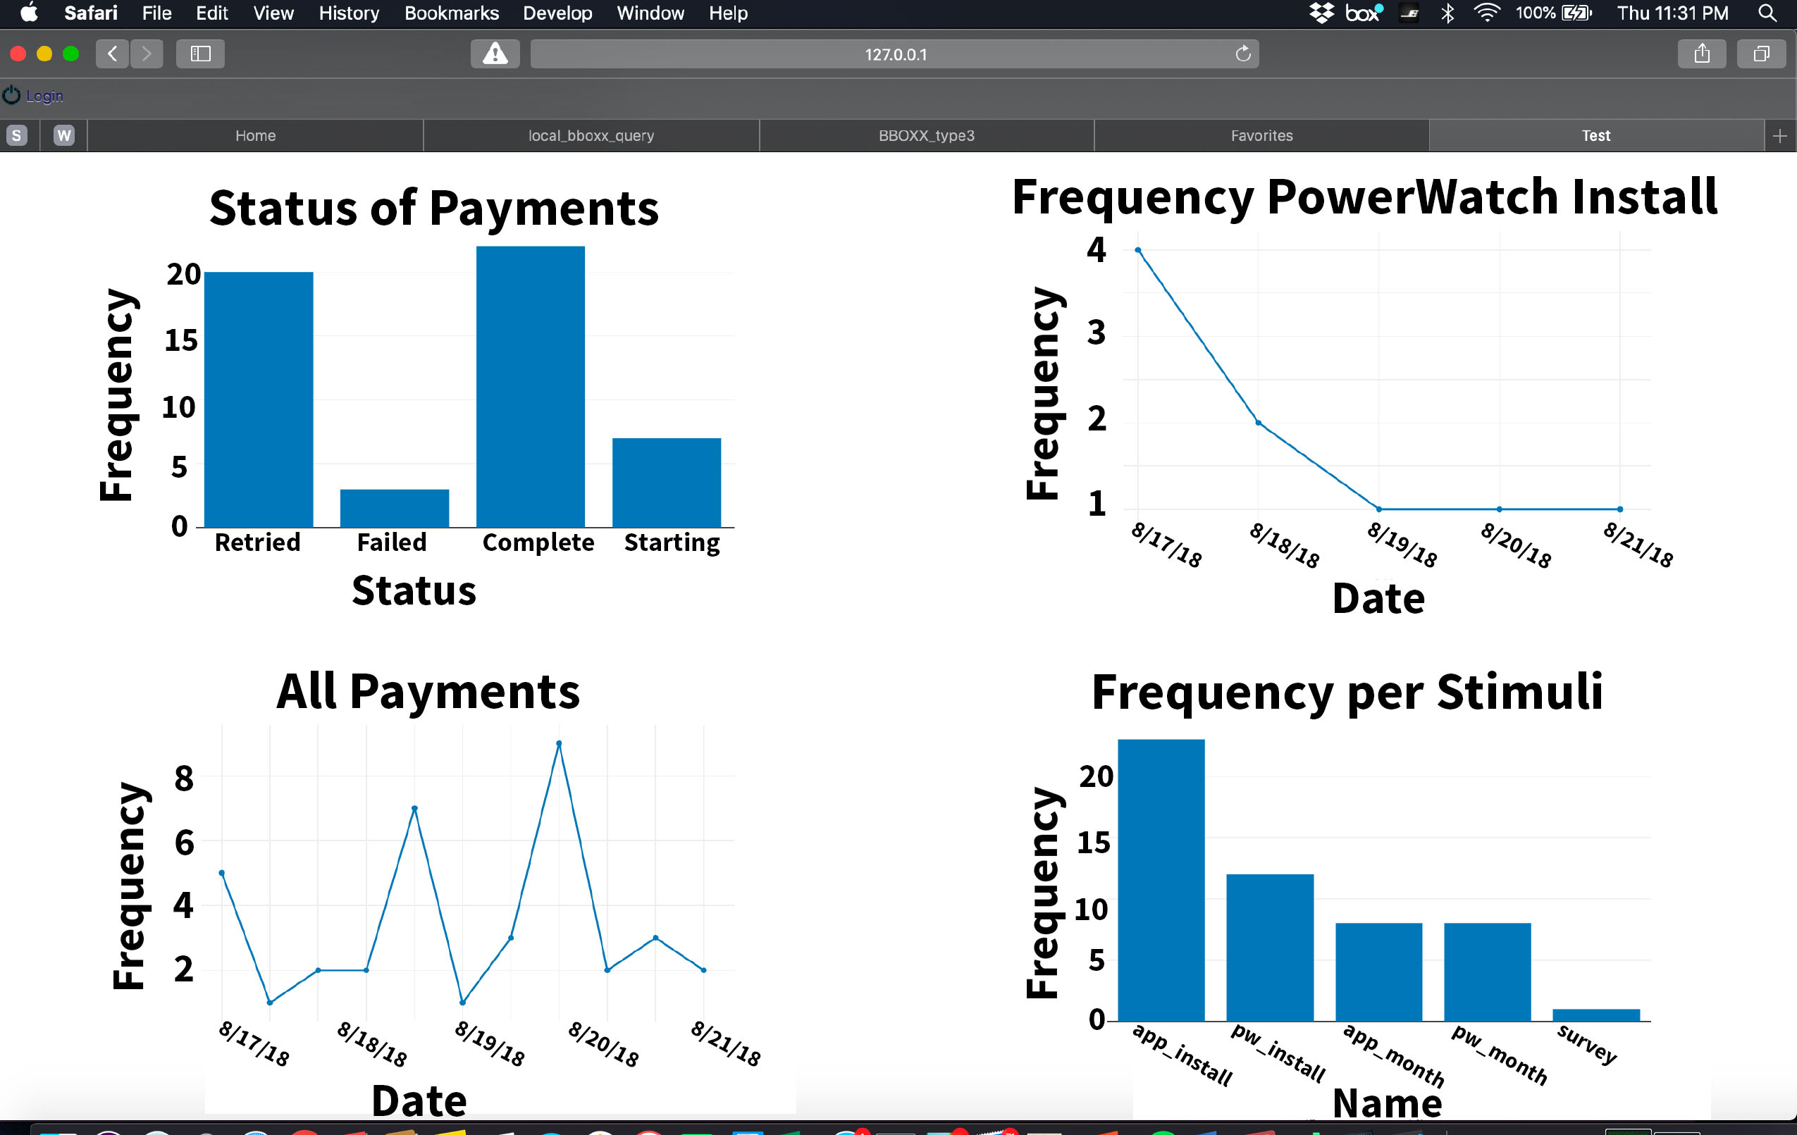
Deployment management
Notes:
Finally, quickly we can show our management interface that we are developing for this all. These are graphs of our incentive payments which are generated automatically and update daily. In practice these have been critical for tracking incentives through the course of our deployment, and we have used them to recognize some poor practices by our field officers.

Slide 14
What we are releasing today
A application-specific implementation of OINK that supports our current experiment
A solicitation for new incentive schemes
What key idioms are we missing?
Can we support your study?
https://openincentivekit.com/
Notes:
So what are we releasing today? Well, [*] we are releasing our implementation of OINK that supports our current experiment. The value of this is primarily to see a template of an OINK system that follows the pattern I just presented, but it is not yet trivially reusable for any experiment. We are also releasing a [*] solicitation on the OINK website for new incentive schemes with the hope that this community can help us fill in any holes in our architecture we might have missed. Both of these can be found at [*] openinventivekit.com.

Slide 15
Works in progress
Open source project
Clear path for function contribution and incorporation
Auto-generation UI
Plain text generated descriptions
Notes:
Simultaneously we will be working on getting a full OINK beta ready for this community to use and contribute to. We have hired a bit of extra engineering support and will be working on getting UI elements together including the interface for auto generating incentive systems and generating plan text descriptions of incentive systems that could be used in the literature. If anyone is interested in being an early adopter, please don’t hesitate to talk with me after this talk.

Slide 16
Closing thoughts
OINK is the first work to generate scalable and auditable incentive systems
The vocabulary we propose could help with reporting and comparing incentive systems in the literature
OINK is designed for non-coders
We are aiming for a community of users and contributors
Notes:
Ok. To quickly summarize. [*] OINK is a piece of software that allows for the creation of incentive systems that can be used in scientific studies. It is designed to both do complicated incentive schemes, but can also be used for something as simple as paying people for a survey. Why would you use it for that? Well OINK logs everything and makes it really each to manage and audit your experiment. [*] I think just as importantly, OINK provides a vocabulary that could be used to describe incentive system in the literature, a practice that is not commonly done and that is important. The common language provided by OINK enables us to directly compare methodologies for experiments that incentivize participants, increasing the repeatability and consistency of the underlying science. [*] OINK is designed so that everyone should be able to use it. We are working hard to make it non coder friendly. [*] Finally, we hope to build a community around this tool, and find inspiration, guidance, and a name from another technology in this community with similar goals, the open data kit or ODK.

Slide 17
Thanks!
https://openincentivekit.com/
Noah Klugman†, Santiago Correa*, Pat Pannuto†, Matthew Podolsky†, Jay Taneja*, and Prabal Dutta†
†
*
Notes:
Thank you so much for listening. I’ll be happy to take any questions.

